Slide 1
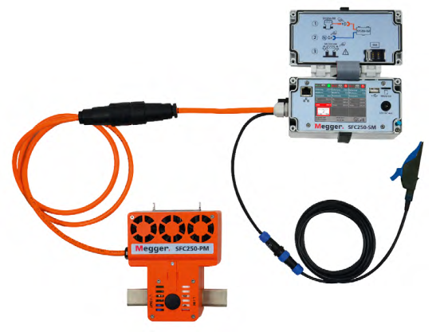
SmartFuse250
Reduce Customer Down Times to a Maximum

Slide 2
SmartFuse250
Replaces conventional fuses up to 250A load current
Online monitoring of current and voltage
Automatic breaking and re-closing
Warnings via SMS/eMail on various events
Integrated cable fault location intelligence
Modular 3-phase system
Compact installation in closed cabinet
Safe remote operation onsite and from control room

Slide 3
Where can SmartFuse250 help to minimize downtimes?
Customers are not available and cannot be disconnected from the faulty cable. Therefore I am not allowed to apply HV surge methods
Intermittent faults significantly increase downtimes. At the same time I am not able to locate the fault.
My organization will benefit or safe penalties if able to reduce downtimes
Automatic and remotely operated systems will prevent violation of working time regulations of my team
I am looking for a simple method to have online insight in my grid incl. full remote access without impact on safety of my assets
My interdisciplinary team with reduced know-how in cable fault location is looking for simpler and safer instruments

Slide 4
SmartFuse250 System description
Power Module: Switch, sensors, tripping logic
Adapter: Interface for extension to multi-phase operation, power supply
Supply Module: Settings, Communication interfaces

Slide 5
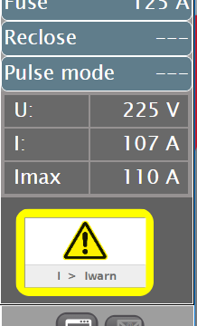
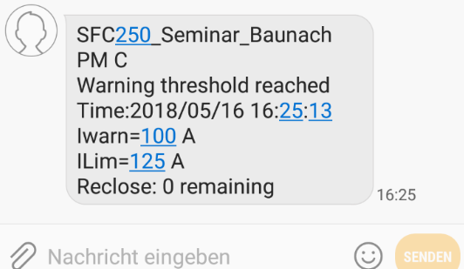
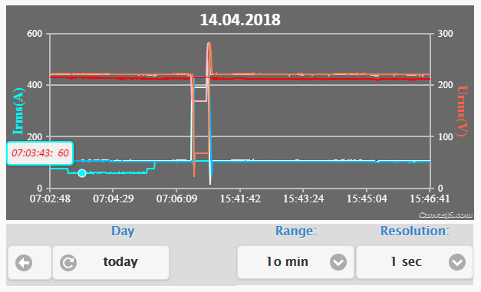
SmartFuse250 manages overload situations
Early warning of impending grid overload (SMS, eMail)
Monitoring and data logging
Limits can be adjusted in operation (also through remote control)
Indication of current direction supports failure analysis

Slide 6
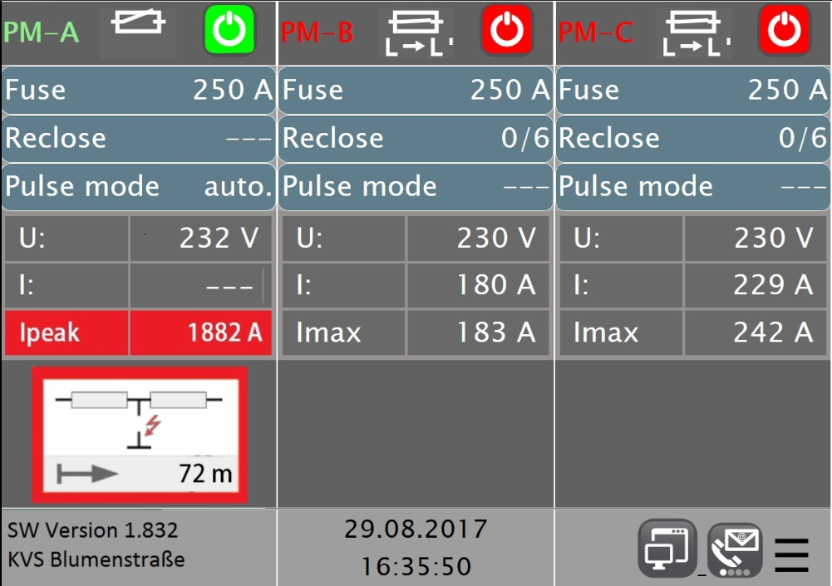
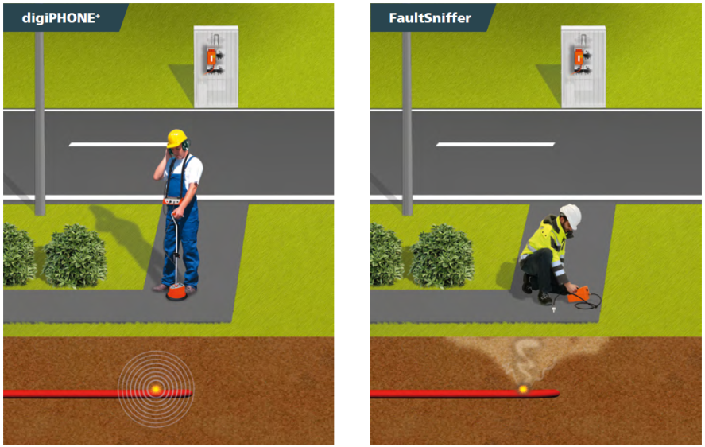
SmartFuse250 manages cable faults
Easy fault location based on intelligent algorithms
Pulsed switching allows pin-pointing of faults
Acoustic surge wave receiver
Sensing combustion gases
Fault location with consumers being connected. Zero-crossing operation of thyristor
Locate also phase-phase fault with 3-phase system

Slide 7
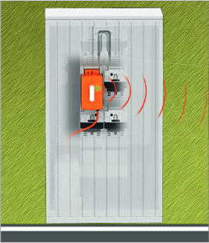
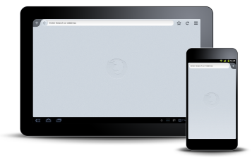
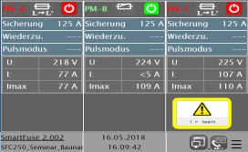
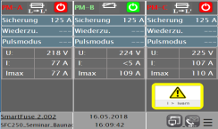
SmartFuse250 - Interfaces
USB
TDR - Trigger
Remote control
Remote control
LAN
Tablet / Smartphone (Wifi)
GPS

Slide 8
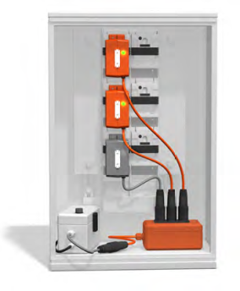
SmartFuse250 - Product at a Glance
The most compact multi-phase system in size and weight on the market to cover most fuse holders/cabinets
First fully modular system to locate faults on all phases
Cheapest solution available providing wearless switch technology and fully integrative communication concepts
Provides full and safe control even through remote access and
Defines new safety standard (closed and capsuled installation, many intelligent safety features)

Slide 9
SmartFuse250 Benefit in reduction of down time!
Customers can stay connected while fault location
Time-consuming and cost-intensive searching for the connected consumers is no longer necessary
Digging up cables to disconnect buildings is dispensed with
Inbuilt algorithm locates also intermittent faults and recloses automatically
Warnings and monitoring data allows early planning of preventive maintananance

Slide 10
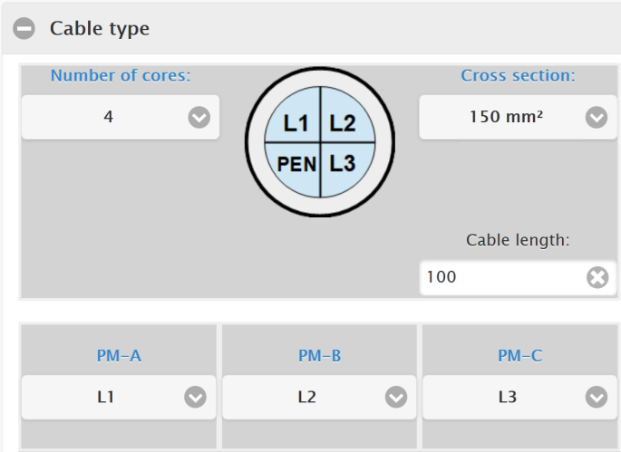
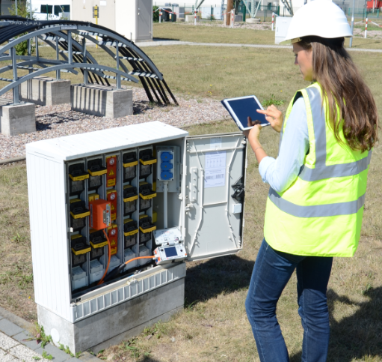
SmartFuse250 Benefit in safety
Automatic operation avoids conflicts with working time limitations and increases grid fees simultaneously
Encrypted remote access via remote contro unit, tablet or from control room
Simple and safe – No specific know-how needed
Proven and intelligent safety mechanisms

Slide 11
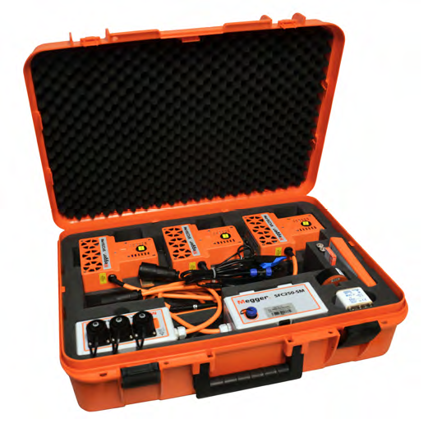
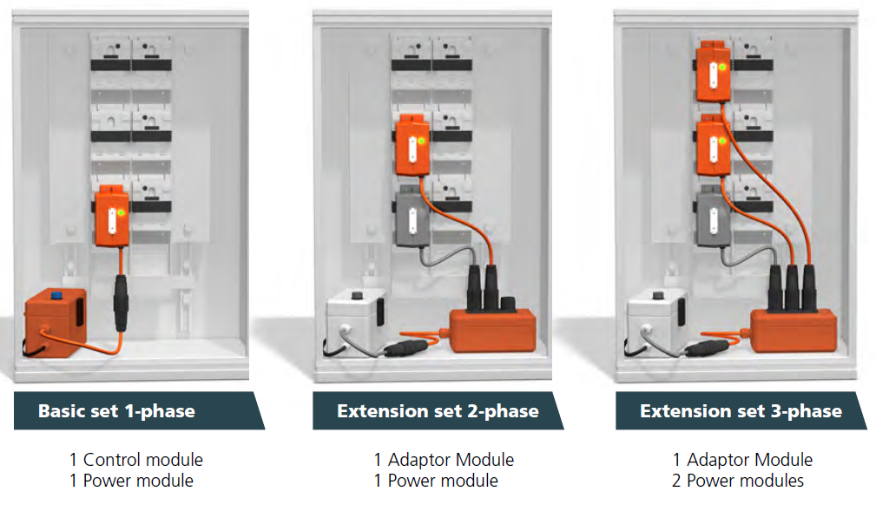
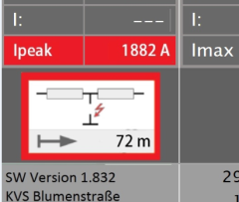
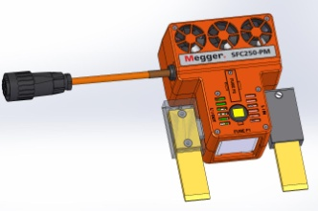
SmartFuse250 Product structure / Options
Option
Fault location
Tablet
Adapter

Slide 12
Questions? Power on At Megger, we understand that keeping the power on is essential for the success of your business. That is why we are dedicated to creating, designing and manufacturing safe, reliable, easy-to-use portable test equipment backed by world-leading support and expertise. We can assist your acceptance, commissioning and maintenance testing for predictive, diagnostic or routine purposes. By working closely with electrical utilities, standards bodies and technical institutions, we contribute to the dependability and advancement of the electrical supply industry.

